Slide 1





SMART INDIA HACKATHON 2026
  Problem Statement ID – 26151
  Problem Statement Title-Dark web threat actor
de-anonymization
  Theme- Blockchain & Cybersecurity
  PS Category- Software
  Team ID-
  Team-
TITLE PAGE
Bennett University

Slide 2
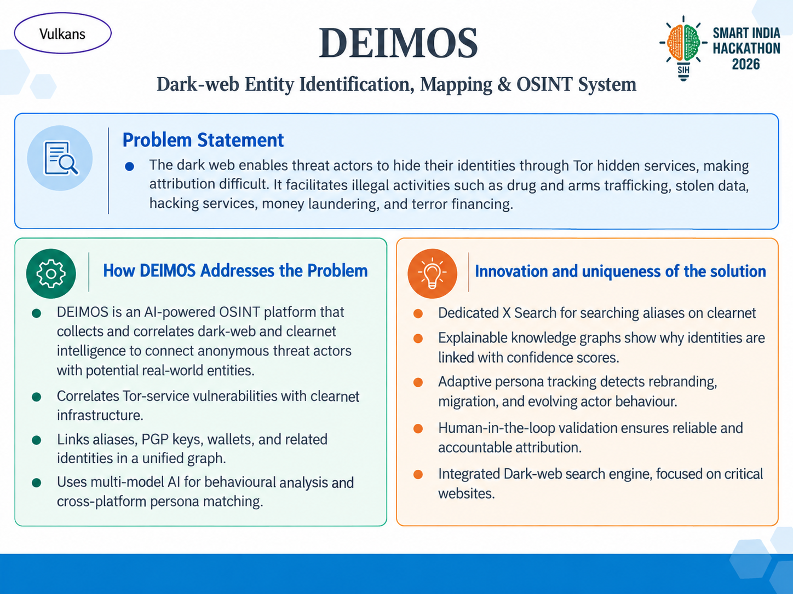
Bennett University

Slide 3
Vulkans
TECHNICAL APPROACH
IMPLEMENTATION METHODOLOGY
Collect
Dark web + clearnet
Correlate
Aliases • PGP • wallets
Analyse
Multi-model AI
Map
Knowledge graph + confidence
Output
Dashboard • alerts • reports
→
→
→
→
SYSTEM FLOW
TECHNOLOGY STACK
Secure Automated
Collection
Profile
Construction
Multi-Model
AI Analysis
Knowledge Graph
Construction
Frontend
Electron • React • TypeScript
→
→
→
Core Services
Go — crawling & concurrent collection
AI Backend
Python • FastAPI • PyTorch • Transformers • LLMs
Sources are collected securely, entities are extracted into profiles, AI analyses patterns and threat signals, and connected evidence is stored as a knowledge graph with confidence scores.
Data Layer
Neo4j • PostgreSQL • Elasticsearch
Collection
Tor proxy • OSINT APIs • web crawlers
Deployment
Docker • VPS • optional NVIDIA GPU
Bennett University
3

Slide 4
Vulkans
FEASIBILITY AND VIABILITY
Feasibility
Potential risks and Challenges
Strategies to Overcome Challenges
Open-source stack
Monitor sources
Unstable dark-web sources
False links / deceptive identities
Electron • Go • Python • Tor • Neo4j • AI
↓
Monitoring • retries • source archiving
Multi-source verification • confidence • human validation
Verify across sources
↓
Modular design
AI grounded in evidence
Phased development, testing & scaling
AI errors / hallucinations
Legal / privacy + sensitive data
↓
Evidence grounding • cross-validation • audit trails
RBAC • lawful-source policies • encryption • access logs
Human validation
Deployment
↓
Standard servers; GPU optional
Secure audited output
VIABILITY: Focused prototype → secure organization-level threat-intelligence platform
Bennett University
4

Slide 5
Vulkans
IMPACT AND BENEFITS
From scattered clues → evidence-linked, actionable threat intelligence
POTENTIAL IMPACT
01
TRACK
02
CORRELATE
03
ASSESS
04
DETECT
Identify & track threat actors
→
Scattered data → linked intelligence
→
AI correlation + confidence scoring
→
Cybercrime • illicit trade • fraud • terror financing
WHY IT MATTERS
SOCIAL
ECONOMIC
OPERATIONAL
NATIONAL SECURITY
EFFICIENCY
Protects citizens & organizations
Reduces losses & investigation costs
Saves analyst time; faster decisions
Stronger monitoring & intelligence sharing
Scalable processing reduces unnecessary compute/storage
EXPECTED IMPACT
Faster investigations
Evidence-linked output
Explainable confidence
Scalable architecture
Bennett University
5

Slide 6
Vulkans
RESEARCH AND RESOURCES
01 RESEARCH & REFERENCES
02 HOW RESEARCH BECOMES DEIMOS
EUROPOL IOCTA
Cybercrime trends, dark-web and cybercrime enablers
europol.europa.eu/.../iocta-report
SOURCES
TEXT ANALYSIS
BEHAVIOUR
GRAPH
OUTPUT
Europol • Tor
research
→
VeriDark •
DarkBERT
→
MITRE ATT&CK
mapping
→
Neo4j entity
relationships
→
Evidence +
confidence
TOR PROJECT
Onion-service architecture, privacy features and protocols
community.torproject.org/onion-services/overview/
VERIDARK — NEURIPS 2022
Cross-platform dark-web persona / author verification
03 ENGINEERING FOUNDATION
proceedings.neurips.cc — VeriDark
DARKBERT — ACL 2023
Dark-web language and textual-pattern analysis
EXPLAINABLE THREAT-INTELLIGENCE PIPELINE
aclanthology.org/2023.acl-long.415/
Secure collection • multi-model AI • confidence scoring • knowledge graph • human validation
MITRE ATT&CK
Mapping observed adversary tactics and techniques
attack.mitre.org
04 CORE PRINCIPLE
NEO4J
Connected entities and relationships in knowledge graphs
AI assists correlation; evidence, confidence and human validation keep attribution accountable.
neo4j.com/product/neo4j-graph-database/
Bennett University
6

